Slide 1

Water Mill Primary School
Phonics & Reading
Parent Meeting
Tuesday 26th March at 2.30pm and 5.00pm

Slide 2

Little Wandle Letters and Sounds Revised
Phonics
A systematic, synthetic phonics programme developed by schools, for schools.
Based on the original Letters and Sounds programme, but extensively revised to provide a complete teaching programme meeting all the expectations of the National Curriculum, the Ofsted Deep Dive for Reading and preparing your children to go beyond the expectations of the Phonics Screening Check.

Slide 3
Little Wandle Letters and Sounds Revised
Phonics
All staff have undergone intense training.
All children have completed a placement assessment with their class teacher to check their current understanding and to help us to ensure we cover any missed content.
Reception, Year 1 and Year 2 have been grouped across the Key Stage, with 6 phonics groups running at the same time, all focussing on the skills the children need to develop.

Slide 4
Little Wandle Letters and Sounds Revised
Phonics
Assessments will be carried out at the end of each half term, making sure we are able to address any missing gaps, but also so we can ensure the children are making consistent progress.

Slide 5
Little Wandle Letters and Sounds Revised
Reading
Timetable includes:
Monday – Whole Class Read
Tuesday – Decoding
Wednesday – Prosody
Thursday – Comprehension
Friday – Reading activities related to Phonics

Slide 6
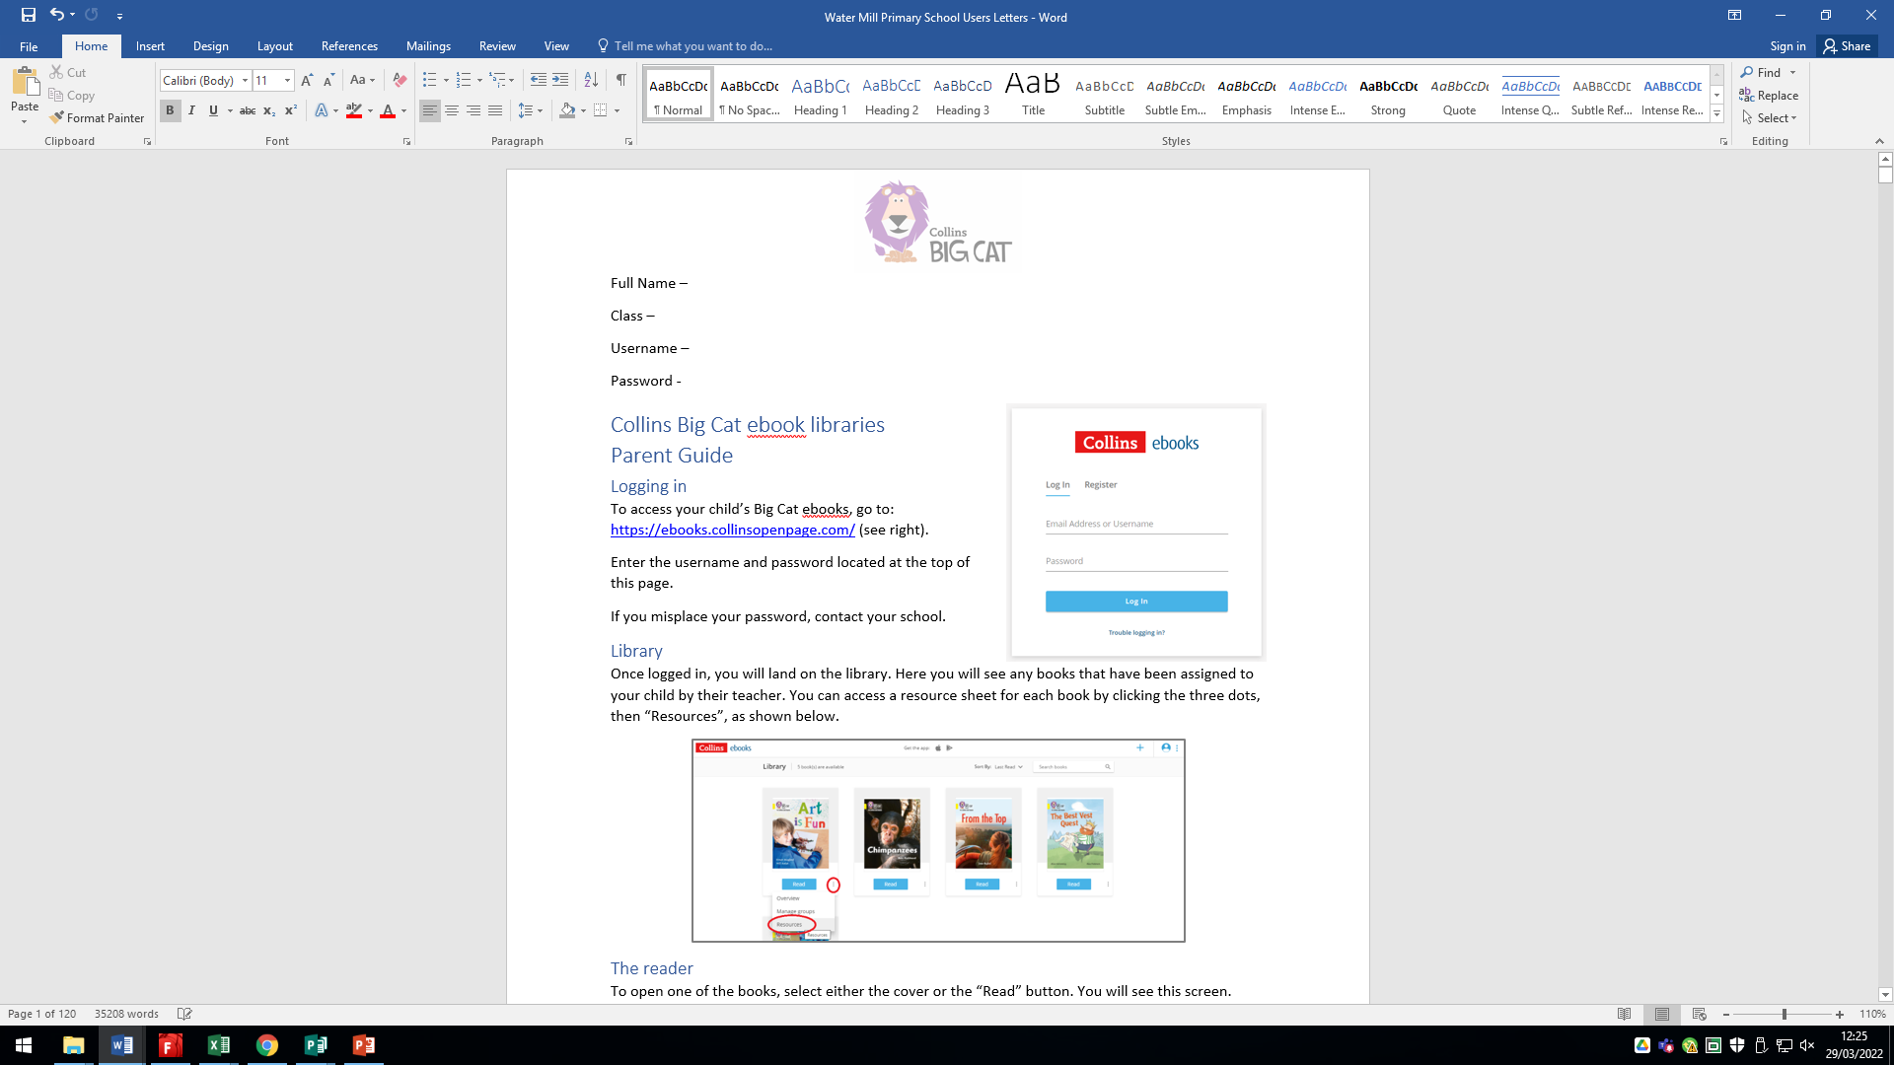
Little Wandle Letters and Sounds Revised
Reading
On a Thursday, the book the children have been reading will be available on the Collins Website. The children will have their own username and password to access this.

Slide 7
Little Wandle Letters and Sounds Revised
Reading
The books online are for the children to read to you. They have read these books 3 times and they should be 90% fluent when reading.
If you have any concerns over your child’s reading ability, please speak to your child’s class teacher.

Slide 8
Little Wandle Letters and Sounds Revised
Reading
Library Books
The children will also bring home a library book, either from their class library or the school library.
These books are not to be used to teach reading.
These books are to be used to develop enjoyment for reading.
These books are for an adult to read to their child.

Slide 9
Little Wandle Letters and Sounds Revised
Phonics & Reading
Catch Up
If at any point, we feel that a child needs extra support because they are falling behind or because they haven’t understood the new learning for a particular day, we will ensure they participate in catch up.
1:1, small group interventions daily – 5 minutes

Slide 10

Little Wandle Letters and Sounds Revised
Phonics & Reading

